Slide 1

CSE347
Information System Analysis and Design
Md. Sabbir Hossain
Lecturer
Department of Computer Science and Engineering
Faculty of Science and Engineering

Slide 2
Data Flow Diagram (DFD)
2

Slide 3
Data Flow Diagram
A data flow diagram (DFD) is a graphical representation of the movement of data between external entities, processes and data stores within a system.
Simply put, DFD’s show how data moves through an information system.
3

Slide 4
DFD Elements
Processes – the main activities that are happening within the system boundary. The process can be as simple as collecting customer data and storing it in the company database. Also, it can be a very complicated process such as creating a report containing bank contracts with customers of all bank clones in a region.
External entities – the sources of information coming to or leaving the system. External entities are outside systems such as people (customers, stakeholders, managers), organizations, computers and other systems that send or receive data from our system.
Data stores – places where data is held such as files or repositories. Data stores show information that is not moving.
Data flows – illustrate the movements that data have between the external entities, data stores, and the processes.

Slide 5
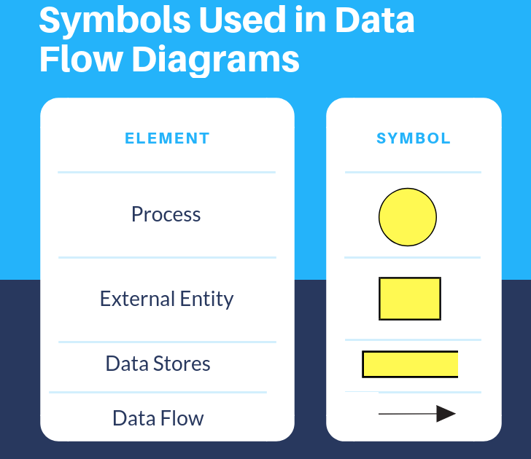
DFD Symbols

Slide 6
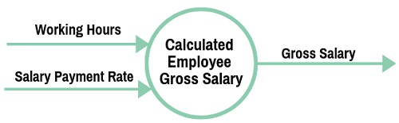
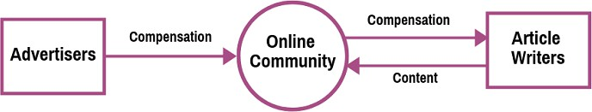
Designing DFD
1. Each process has at least one outgoing data flow and at least one ingoing data flow.
2. Each process can go to any other symbol (other processes, data store, and entities).

Slide 7
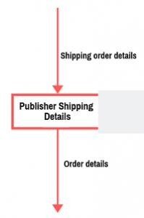
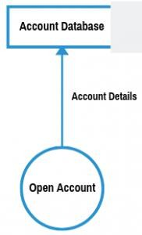
Designing DFD
3. Each data store should have at least one incoming and at least one outgoing data flow.
4. Entities must be connected to a process by a data flow

Slide 8
Designing DFD
Data flows cannot cross with each other.
Data stores cannot be connected to external entities. Otherwise, it means you’re allowing an external entity access to your data files and stores.
The labels of processes can be verb phrases. Data stores are displayed by nouns.
Data flows cannot run between two external entities without going through a process

Slide 9
Advantages of DFD
A graphical technique that is relatively easy to understand for stakeholders and other users.
Provides a detailed view of the system components and boundaries.
Provide clear and detailed information about the processes within a system.
Shows the logic of the data flow.
Presents a functional breakdown of the system.
Used as a part of the system documentation.
9

Slide 10
Disadvantages of DFD
Takes a long time to create.
Does not give any information about the timing, sequence, and synchronization of processes i.e., data flow diagrams do not specify when the processes are performed. Therefore, it should not be confused with a process or flowchart diagram which can illustrate these things.
Sometimes might be difficult for non-technical users to understand the diagram
10

Slide 11
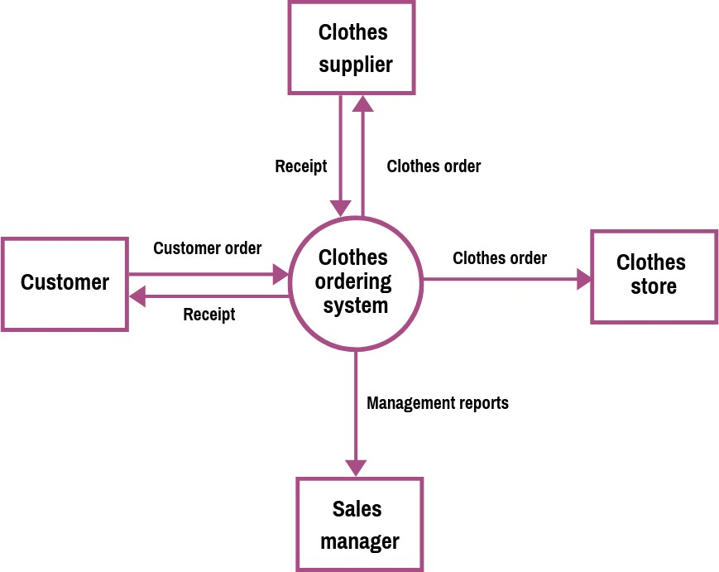
Example: Level 0
11

Slide 12
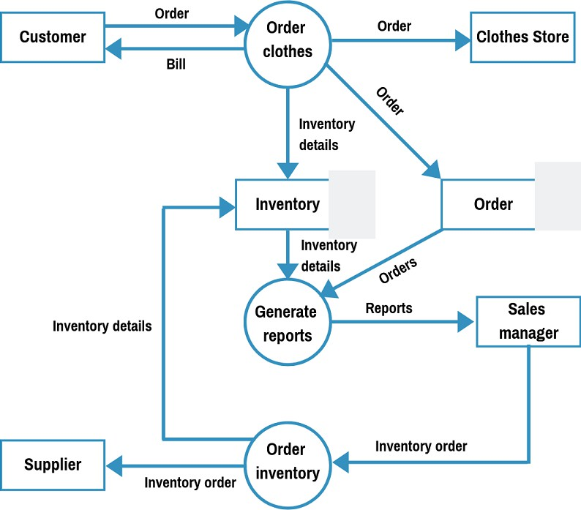
Example: Level 1
12

Slide 13
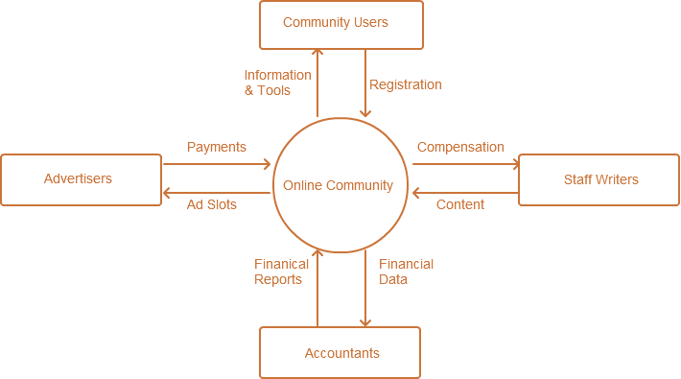
Example 2
13

Slide 14
Let’s draw the level 1 DFD
for the previous Example
14

Slide 15
Exercise: Order Management
Let’s think about an automated ordering process for a shop. The customer sends a product name to check the status of a product. That product name gets stored in order database and fetches the product info. After checking the status one can confirm the order. The customer needs to provide payment info to confirm the order to the cashier. A cashier will send the purchase info to process input data and store the purchase info in- shop inventory. The customer can issue a receipt which will be retrieved by billing info from the shop inventory. They can also cancel orders by initiating cancellation through the cashier.

Slide 16
Hints: Order Management
Let’s think about an automated ordering process for a shop. The customer sends a product name to check the status of a product. That product name gets stored in order database and fetches the product info. After checking the status one can process the order. The customer needs to provide payment info to confirm the order to the cashier. A cashier will send the purchase info to process input data and store the purchase info in- shop inventory. The customer can issue a receipt which will be retrieved by billing info from the shop inventory. They can also cancel orders by initiating cancellation through the cashier.

Slide 17
Exercise: Appointment Booking
Let’s think about an automated doctor’s appointment booking process in a hospital. The patient enters the doctor’s name to check his free schedule. That name enters storage named Doctor’s Register and fetches the free schedule. After checking the status one can confirm the appointment. A patient needs to send payment during confirming an appointment at the reception. The reception will send the booking info to process input data and store the booking info in the appointment registrar. The patient can download the receipt which will retrieve data from the Appointment Registrar. They can also cancel an appointment by initiating a cancellation through reception.

Slide 18
Hints: Appointment Booking
Let’s think about an automated doctor’s appointment booking process in a hospital. The patient enters the doctor’s name to check his free schedule. That name enters storage named Doctor’s Register and fetches the free schedule. After checking the status one can confirm the appointment. A patient needs to send payment to confirm the appointment at the reception. The reception will send the booking info to process input data and store the booking info in the appointment registrar. The patient can download the receipt which will retrieve appointment data from the Appointment Registrar. They can also cancel an appointment by initiating a cancellation through reception.

